Slide 1
Future price & Proportional price Stage 4 (Proposal)

Slide 2
Specification
https://kone.sharepoint.com/teams/10027/Project%20documents/Specifications%20for%20KCC/Wiki%20for%20Azure%20DevOps/KCC%20pricing%20over%20view%20including%20proportion%20price%20%2Bfuture%20price%20feature%20v2.xlsx?d=w80a44f84fc0e438e8feaf92decf76e38

Slide 3
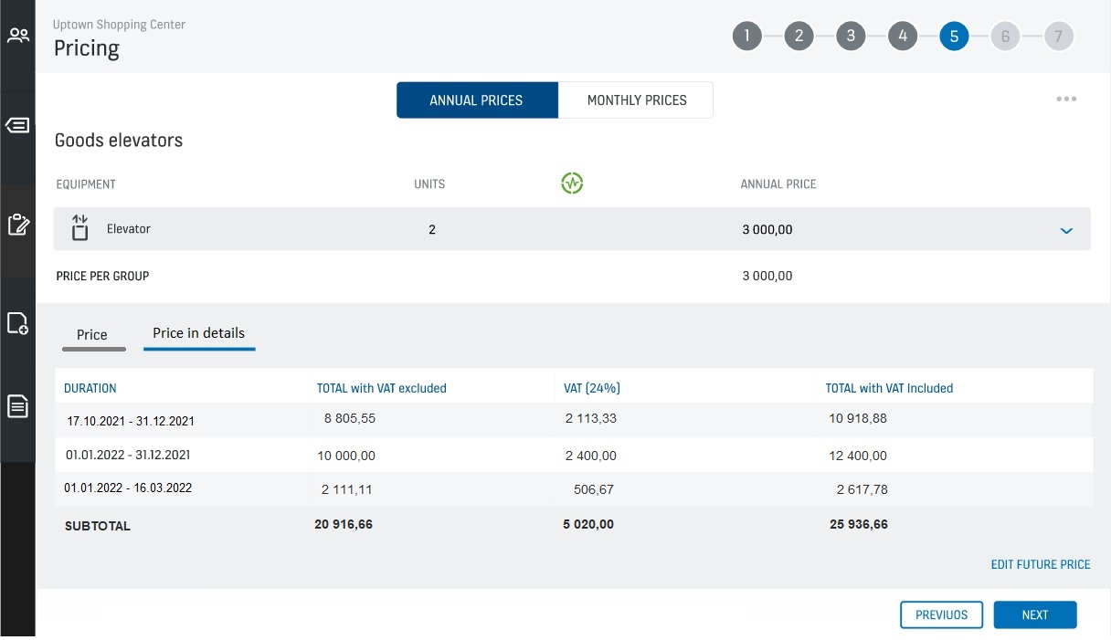
Subtab ‘Price in detail’ in the Price Page
When FLs have configured either or both the commercial terms(Proportional, Future price) in MBS, then we can show the Subtab ‘Price in detail’ in the bottom of the price page.
For Multiple VATs, there should be separate columns to show the VAT calculated price

Slide 4
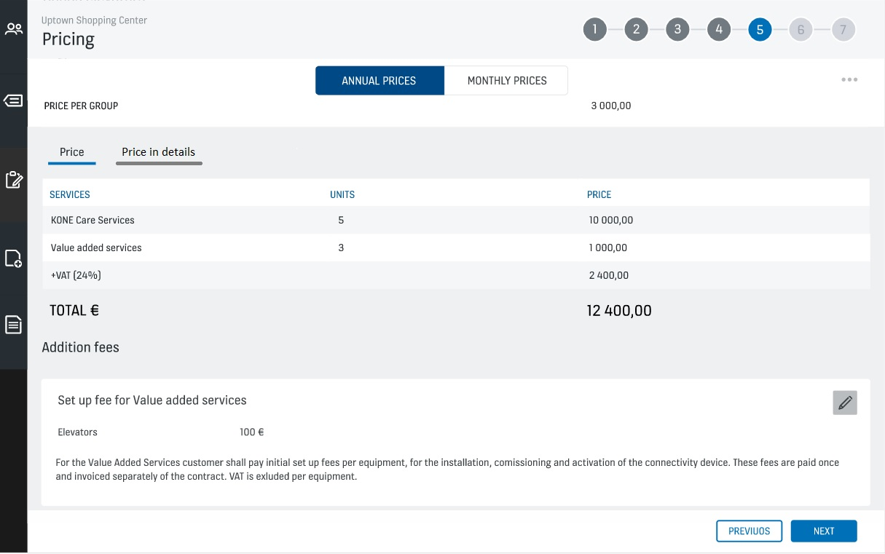

Slide 5
Scenario 1: When it’s only Annual price in the offer (FL has configured Proportional price and Future price in the MBS commercial terms)
Commercial terms selection: Proportional price -> No
Future price -> No
Price Page: In the Sub-tab ‘Price in detail’, Not Applicable.
(Disclaimer: Good to check for NFT performance issues, if any)

Slide 6
Scenario 2: Yearly price with Future price
Commercial terms selection: Proportional price -> No
Price group(Future price) -> FP or K2
Contract duration: Greater than one year
Contract Start date: DDMMYYYY
In the Price Estimation box, user will be able to add the price interms of MV or % for future years based on Contract duration.
Price Page: In the Subtab ‘Price in detail’ there will be Duration, Total(with VAT excluded), different VAT calculated price, Total (with VAT included)
Also, an additional row in the last to show Subtotal for columns ‘Total with VAT excluded’, ‘VAT prices’,
‘Total with VAT included’.

Slide 7
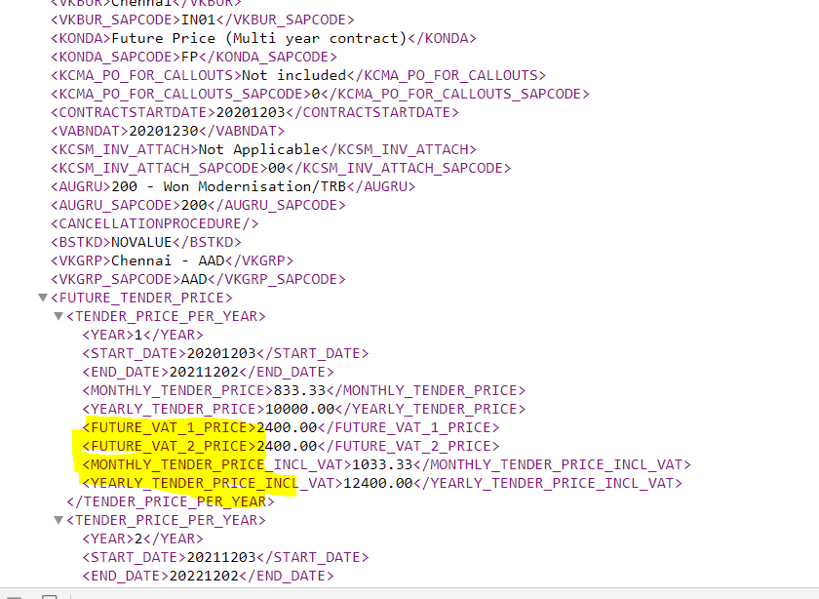
Gendoc: Adding new nodes for showing VAT price and total price with VAT for ranges in Future price nodes
New nodes to be added and have to be checked with gendoc team

Slide 8
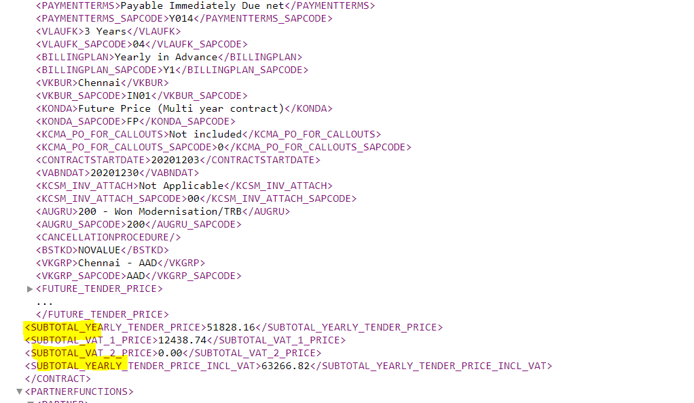
Gendoc: New nodes for showing Sub-total price (Annual + Future price)
To be checked with Gendoc team for the new node
New nodes to be added for Showing the Sub-total prices(Price excluding VAT, different VAT prices, Price including VAT)
(New nodes can be added next to Future_Tender_price

Slide 9
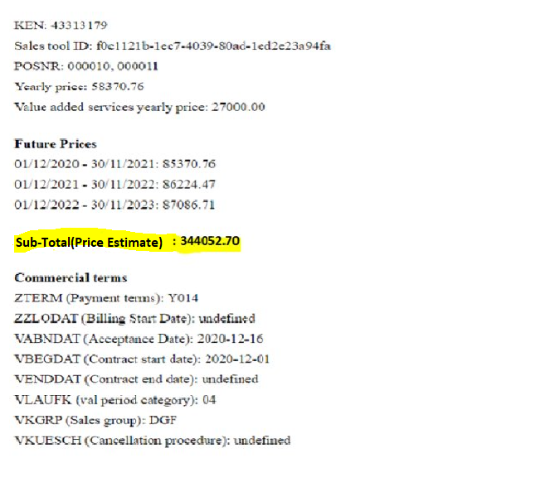
Enabler: New nodes for showing Sub-total price
Good to have this information also added. In enabler, price would be always without VAT

Slide 10
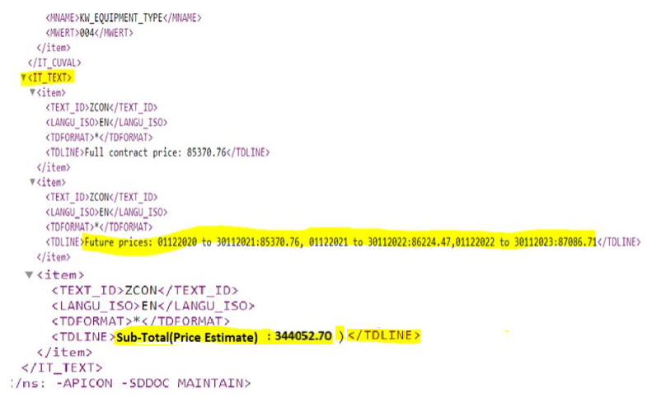
SAP OI XML: Contract notes with information on Future price and Sub-total
Date range and its future price(without VAT)
Sub-total price without VAT

Slide 11
Scenario 3: Proportional price
Commercial terms selection: Proportional price -> Yes
Price group(Future price,K2) -> No
Contract Start date: DDMMYYYY
Acceptance date: DDMMYYYY
In the Price Estimation box, user will be able to view the calculated proportional days for days from Start date to Acceptance date
Price Page: In the Subtab ‘Price in detail’, Proportionally calculated price for days from start date to Acceptance date would be shown under the headers [ Duration, Total(with VAT excluded), different VAT calculated price, Total (with VAT included) ]

Slide 12
(Contd….)
In Gendoc XML, the proportional price nodes for VAT %, VAT Amount and Price with VAT are existing and no changes required.
Enabler: No changes required as Separate section for showing proportional price is a part of stage 3 development.
SAP OI XML: Proportional price with Date range to be send in the contract notes

Slide 13
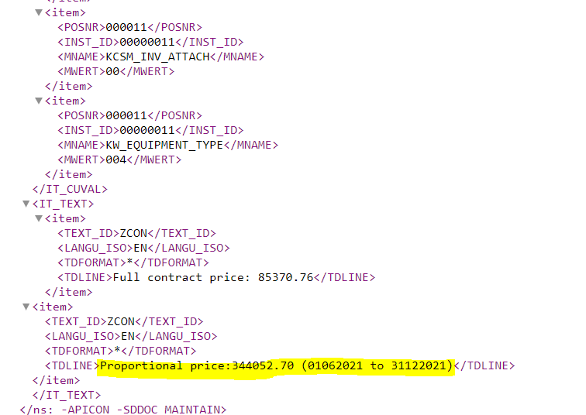
SAP OI XML: Contract notes with information on Proportional price
Must have this change
Date range and its proportional price without VAT

Slide 14
Scenario 4: Selection of both Proportional and Future price
Commercial terms selection: Proportional price -> Yes
Price group(Future price, K2) -> Yes
Contract Start date: DDMMYYYY
Acceptance date: DDMMYYYY
Contract duration(VLAUFK): Not Mandatory(As contract duration can be less or greater than
1 year for which the user can split in different ranges)
In the Price Estimation box:
Price duration rows are automatically created for the user based on the start date and acceptance date. User cannot change the start date of first row but can freely edit all other dates rows. The Price and change % percentage value in the first row cannot be edited.
The logic how the rows are created by default is following:
If duration will not end in the on-going year, to-date will be automatically the last day of the year (for example. 21.10.2020-15.03.2023 then first row would be 21.10.2020-31.12.2020)
If duration includes full years, then those will automatically create row (for example. 21.10.2020-15.03.2023 then first row would be 21.10.2020-31.12.2020 and second row is 1.1.2021-31.12.2021)
If duration which includes full years ends in middle of the year, then that would be the last row and last "to"-date would be the acceptance date (for example. 21.10.2020-15.03.2023 then first row would be 21.10.2020-31.12.2020 and second row is 1.1.2021-31.12.2021 and last row 1.1.2022-15.3.2022)
User can add new rows by clicking on (+) Add duration. A row gets added for FROM and TO calendar fields, Price(in Annual) and Change %. By default, for the first added duration range, we can copy the Start date for FROM field (from previous rows to-column date +1 day) and for TO field, the user can add the date.
If the date entered in the last To field do not match with the Acceptance date selected in the commercial terms, OK button should be disabled
Total number of rows that can be set at max is 10
In Price in details-tab, show proportional price

Slide 15
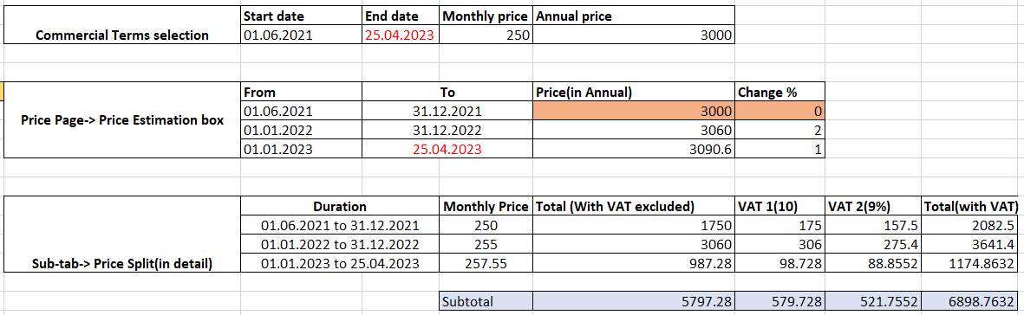
In the Price in detail:
The proportional price for the duration would be shown under the column ‘Total(with VAT excluded)’, then actual monthly price(Computed from Annual), different VAT prices calculated on top of ‘Total(with VAT excluded)’ and final price(Total with VATs).
Example 1:
Not editable
Editable
Important:
Proportional price calculation logic should not be changed
Actual calculated Proportional price is based on Annual price value of the same duration from Price estimation

Slide 16
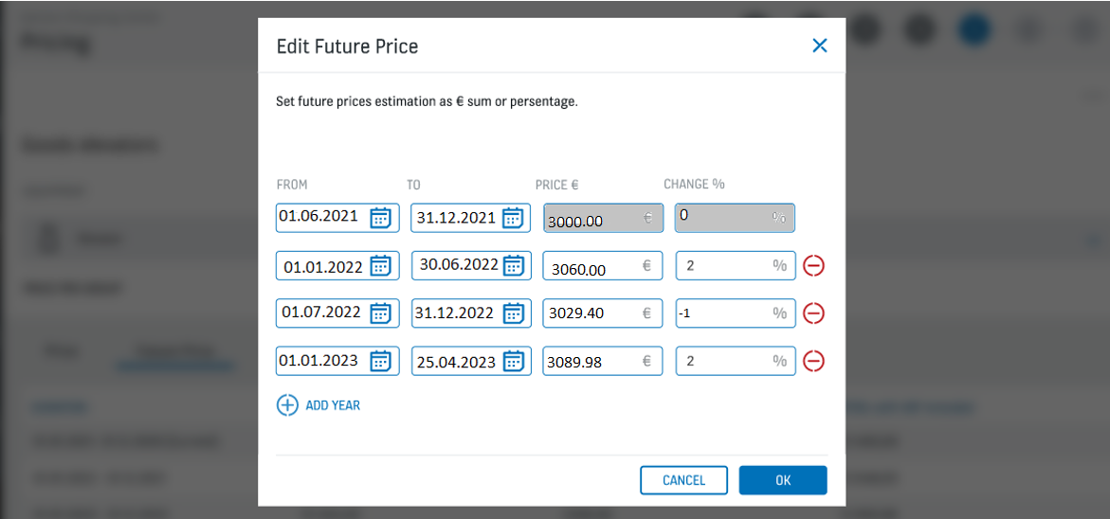
Price Estimation box
Tool will automatically propose duration for user
Change % cannot be negative
Price and change % will be by default empty from the second row onwards

Slide 17
Gendoc: Adding new nodes for showing VAT price and total price with VAT for ranges in Future price nodes
New nodes have to be added and checked with gendoc team

Slide 18
New nodes for proportional future price
Proposal coming from Anna

Slide 19
Gendoc: New nodes for showing Future price Sub-total price
To be checked with Gendoc team for the new node
New nodes to be added for Showing the Sub-total prices(Price excluding VAT, different VAT prices, Price including VAT)
(New nodes can be added next to Future_Tender_price

Slide 20
Enabler: New nodes for showing Future price Sub-total price
Good to have this information also added. In enabler, price would be always without VAT

Slide 21
SAP OI XML: Contract notes with information on Future price and Sub-total
Date range and its future price(without VAT)
Sub-total price

